Slide 1

Grizzly 2
Dima Ionut Daniel

Slide 2
Contents
What is Grizzly?
Architecture
GrizzlyFeatures
Grizzly Core
Memory Management
IO Strategies
Transports and Connections
HTTP Server
WebSocket Support
HTTP Client
Performance
Conclusions
Bibliography

Slide 3

What is Grizzly?
Grizzly is a ramework that uses Java NIO API.
Grizzly’s goal is to help developers build scalable and robust servers using NIO.
Grizzly is an estensible framework and has support gor WebSocket, Comet.

Slide 4
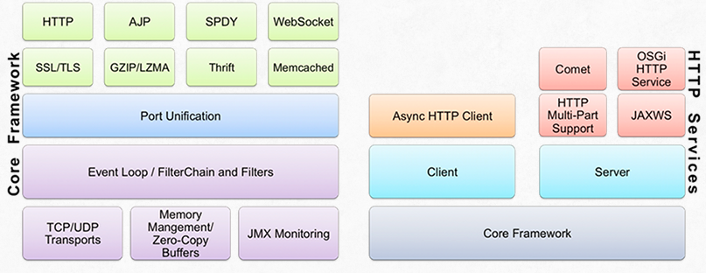
Architecture
Grizzly can be used to write client/server applications using Java NIO API.

Slide 5
Grizzly Features
Interceptor Pattern(Filters)
Custom protocol support(HTTP, AJP, WebSockets, SPDY, etc)
POJO support for encoding/decoding
Custom thread model support
Documented and API
Access to buffers
Socket independence and abstraction

Slide 6
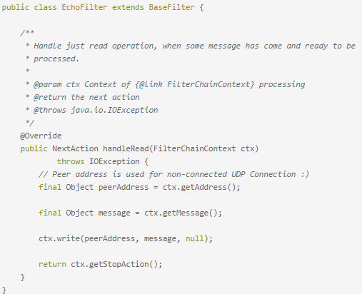
Grizzly Core
BaseFilter class is used for handling incoming messages.
TCPNIOTransport is used for creating TPC transport layer.

Slide 7
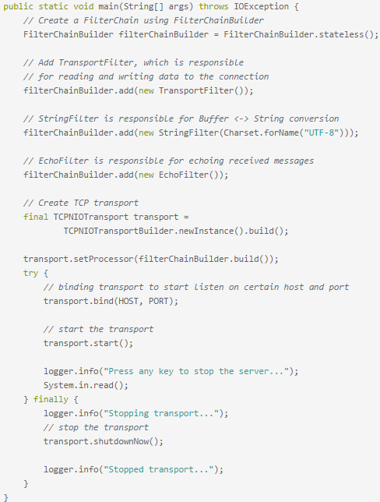
Grizzly Core (cont.)

Slide 8
Memory Management
Grizzly 2 has a new susbsystem to improve mememory management.
The subsystem is comprisef of 3 main artifacts:
Buffers.
Thread local memory pools.
MemomyManager as a factory of sort using the buffers and thread local pool.
There is tipically a single MemoryManager servicing all transports defined withing Grizzly runtime.
The MemoryManager can be obtained using MemoryManager.DEFAULT_MEMORY_MANAGER.

Slide 9
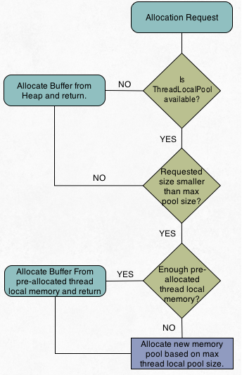
Memory Management (cont.)
Grizzly 2.3 includes 2 MemoryManager implementations:
HeapMemoryManager – default used by Grizly and wrap byte arrays directly.
ByteBufferManager – uses JDK ByteBuffer instances.
ThreadLocal memory pools provide the ability to allocate memory without any syncrhonization costs.

Slide 10
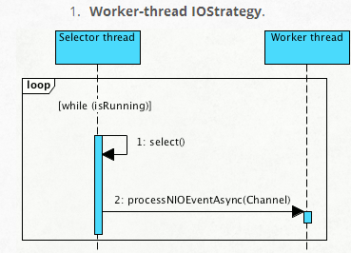
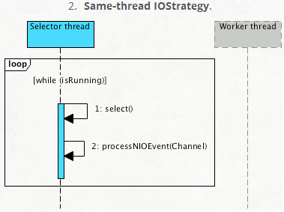
IO Strategies
There are 2 options of processing NIO events:
Process NIO event in the same selector(thread).
Pass NIO event to a worker thread.

Slide 11
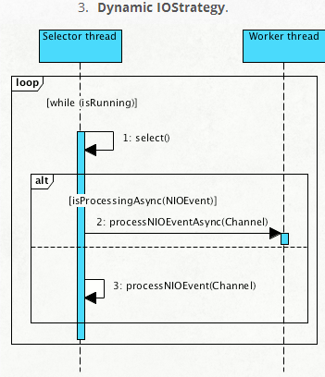
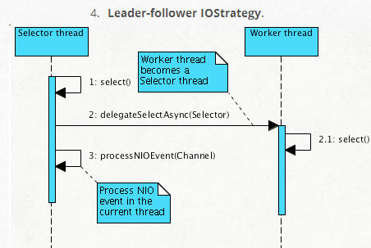
IO Strategies (cont.)
The Leader-follower IO strategy was included in Grizzly 2.3

Slide 12
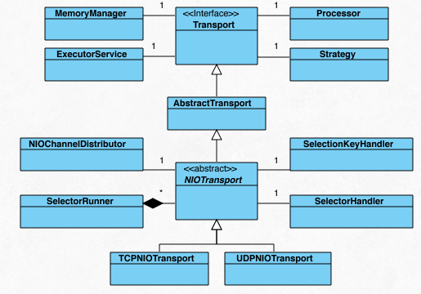
Transport and Connections
Transport/Connection represent the core network API.
Transport defines a network transport such as TCP or UDP.
Connection represents a single network connection depending on type of Transport.
Connection can be of type UDP, TCP or any custom connection type.

Slide 13
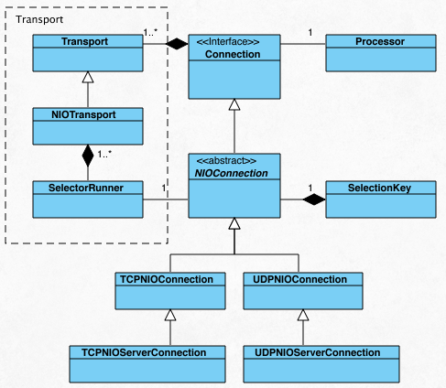
Transport and Connections (cont.)
Transport/Connection represent the core network API in Grizzly 2.
It defines a network transport such as TCP or UDP, including associated resources(thread-pool, memory mana.ger,etc)

Slide 14
Transport and Connections (cont.)
Auxiliary componnets:
MemoryManager → implements memory allocation/release logic.
ExecutorService → represents the Transport associated thread-pool.
Strategy → implements IOStrategy.
SelectorRunner → implements single thread logic which sends the events to the Processor.
Processor → transports default Processor logic, responsable for processing NIO events.

Slide 15
HTTP Server
Grizzly HTTP Server framework builds the HTTP codec framework and includes:
Simple server API for embedding Grizzly
HttpHandler,Request, Response objects, similar to Servlet, HttpServletRequest, HttpServletResponse.
Support for non-blocking IO streams.
Cache mechanism for static content.
Create HTTP transactions via suspend/resume facilities.
HttpServer is the Grizzly HTTP Server that is used for creating the http server.
ServerConfiguration adds custom HttpHandler implementations to the server.
NetworkListener represents the abstractization of Grizzly NIOTransport and Filter implementations.

Slide 16
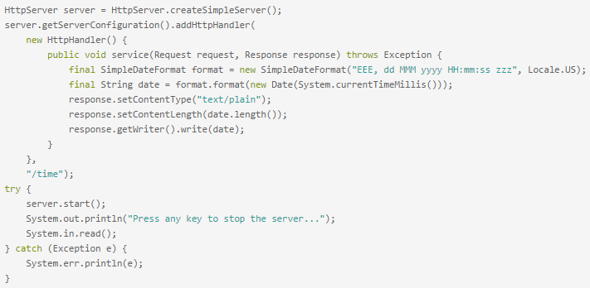
HTTP Server (cont.)
Sample simple HttpServer configuration:

Slide 17
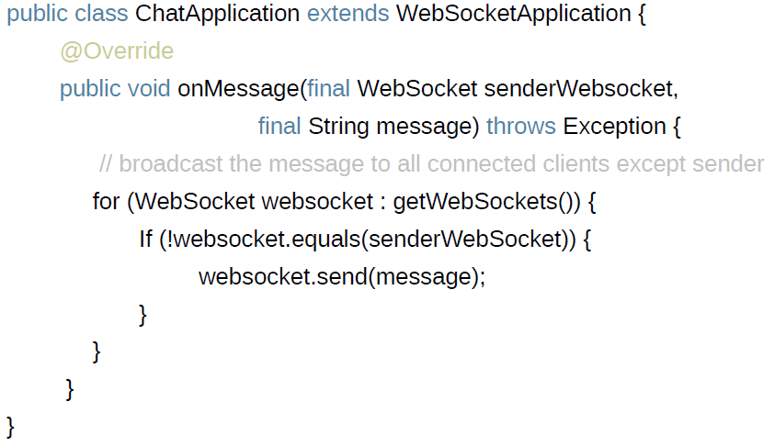
WebSockets Support
The Websocket protocol is designed for bidirectional communication that use HTTP as transport layer.
The WebSocket is defined under RFC 6455.

Slide 18
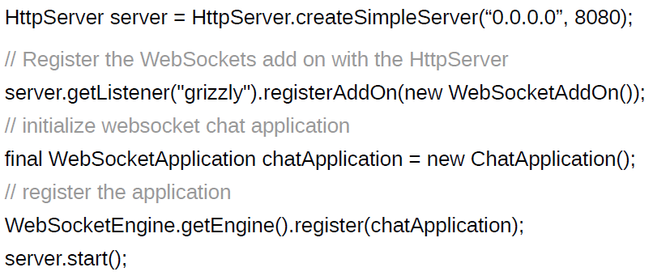
WebSockets Support (cont.)
PROS:
Uses single TCP socket
Full-duplex communication, effective bi-directional
HTML 5 standard

Slide 19
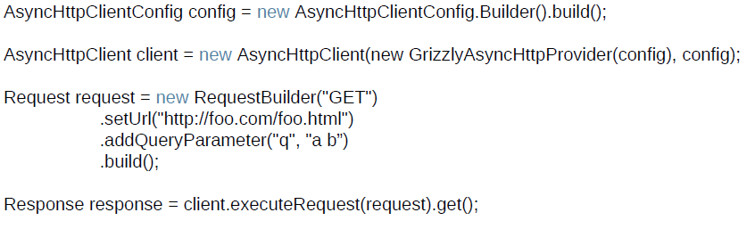
HTTP Client
Grizzly has a HTTP Client and uses non-blocking HTTP handling that the server-side uses.
The AsyncHttpHandler object can be passed to executeRequest method and provides callbacks like:
onBodyPartReceived, onStatusReceived, onHeadersReceived, onCompleted.

Slide 20
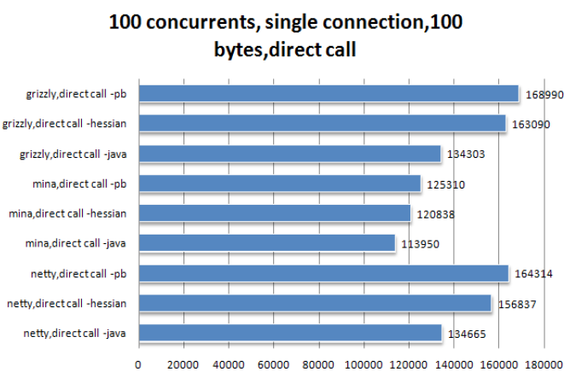
Performance

Slide 21
Conclusions
Grizzly is a very to use NIO framework.
Grizzly is documented.
Grizzly is very performant.

Slide 22

Bibliography
http://en.wikipedia.org/wiki/Project_Grizzly_(software)
https://grizzly.java.net/

